Slide 2
The Cloud Tour

Slide 3
Getting started with Cloud computing

Slide 4
Introduction
Have you ever wondered what cloud computing is?
It's the delivery of computing services over the internet, which is otherwise known as the cloud.
These services include servers, storage, databases, networking, software, analytics, and intelligence.
Cloud computing offers faster innovation, flexible resources, and economies of scale.
Cloud computing offers the use of computing resources as a service.
A cloud computer is simply a large distributed computing infrastructure that users have access to over a network.
Similar to some other domains, cloud computing came about through the maturity of enabling technologies while attempting to satisfy economic needs.

Slide 5
The evolution of Cloud computing
1950-66 | 1969-93 | 1995-00 | 2006-07 | Present
1950: Herb Grosch suggested the idea that having 15 large datacentres should suffice the computing needs of the world 1960: John McCarthy proposed the idea of computation being conveyed as public utility 1966: Douglas Parkhill aimed to explain the modern-day characteristic of cloud computing in the book “The challenge of the Computer Utility” | 1969: Advanced Research Development Projects Agency Network (APRANET) has taken its steps to developments. During the same year, UNIX was developed. 1990: Internet age was started 1993: The use of browsers were popularized in accessing the WWW(World Wide Web) | 1995: Online businesses including Amazon and eBay were launched to the public. 1999: Salesforce.com was launched, resulting in one of the first software-as-a-service offerings. 2000: Dot com bubble bursts, forcing companies to cut costs on infrastructure and improve datacentre efficiency and utilization. | 2006: Amazon launches Amazon Web Services(AWS), offering storage services in the form of Amazon S3, and compute resources in the form of Amazon EC2. 2007: Salesforce launched force.com, which is a cloud computing platform as a service system from salesforce.com | Several start-ups launched. Start-ups today leverage cloud computing services in order to reduce capital expenditure and scale rapidly as their service popularity grows.
Ideas | Technologies | Realities

Slide 6
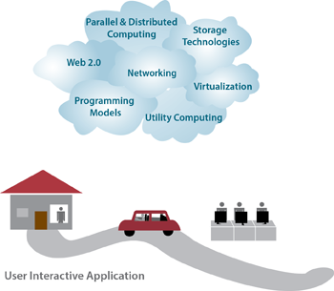
Enabling technologies
Cloud computing has various enabling technologies, which include:
Networking
Virtualization
resource management
utility computing
programming models
parallel and distributed computing
storage technologies.

Slide 7
Cloud computing advantages
High availability
Scalability
Vertically
Horizontally
Elasticity
Agility
Geo-distribution
Disaster recovery

Slide 8
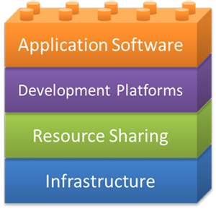
Building blocks of the cloud
We present four main building blocks in cloud computing: application software, development platforms, resource sharing, and infrastructure, The infrastructure includes the physical resources in a datacenter. The resource sharing layer typically entails software and hardware techniques that allow the sharing of the physical resources while offering a certain level of isolation. The development platforms are utilized to develop cloud applications.

Slide 9
Cloud computing services
In a broad sense, cloud services differ based on the needs of different users. This section reviews three popular types of cloud services:
Software as a Service (SaaS)
Product as a Service (PaaS)
Infrastructure as a Service (IaaS)

Slide 10
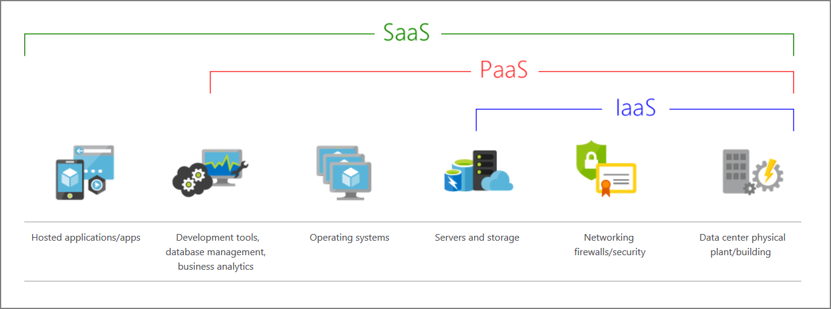
Cloud computing services – The big picture

Slide 11
Software as a Service (SaaS)
(definition) Software as a service (SaaS) is a software delivery model in which software and associated data are hosted on a cloud. SaaS applications typically are accessed by users using a thin client via a web browser.
Cloud provider delivers software as an internet service.
SaaS users simply use their browsers to access the software, thus eliminating the need to install, run, and maintain (update, patch, reconfigure, and so on) the application on their computers.
The web browser loads the SaaS application service dynamically and transparently.

Slide 12
SaaS Characteristics
Typical characteristics of SaaS include:
Access to the software service is web based.
Software is managed from a central location by the cloud provider.
Software is delivered in a one-to-many model in which "one" is the cloud provider and "many" is the cloud users.
The cloud provider handles software upgrades and patches.

Slide 13
SaaS use cases
SaaS is favored for:
Applications that are fairly standardized and do not require custom solutions. E-mail is a good example of a fairly standardized application.
Applications that have a significant need for remote/web/mobile access, such as mobile sales management software.
Applications that have a short-term need, such as collaborative software for a particular project.
Applications in which demand spikes significantly, such as tax or billing software that is used once a month.

Slide 14
SaaS use cases
SaaS is not favored for:
Applications that require offline access to data.
Applications that require significant customization.
Applications in which policies or regulations disallow data from being hosted externally.
Applications in which existing in-house solutions satisfy all of the organization's needs.

Slide 15
SaaS examples
Webmail is one of the early examples of SaaS
Can be accessed by a web browser at any time, anywhere
Offerings like Outlook, Yahoo Mail, and Gmail
Based on ‘Freemium’ model
Source of revenue mainly from advertisements that are displayed to the users as they use the service.

Slide 16
Platform as a Service (PaaS)
(definition) Platform as a service (PaaS) is a computing platform that allows for the creation of web applications in a simplified manner without the complexity of purchasing and maintaining any of the underlying software and infrastructure.
Allow users to develop, deploy, and scale applications on platforms that are offered by cloud providers
PaaS is analogous to SaaS

Slide 17
PaaS characteristics
Services to develop, test, deploy, host, and maintain applications in the same integrated development environment (IDE).
Web-based user interface (UI) creation tools to help create, modify, and test various UI scenarios.
Multitenant architecture in which multiple concurrent users utilize the same development tools.
Built-in scaling mechanisms of deployed software that can be handled automatically by the cloud provider by load-balancing and failover mechanisms.

Slide 18
PaaS use cases
PaaS is favored for:
Rapid application development scenarios.
Applications that require web-based infrastructure to handle varying loads from users.
Applications that may not need redeployment or migration to other platforms in the future.

Slide 19
PaaS use cases
PaaS is not favored when:
The application needs to be highly portable in terms of where it is hosted because PaaS APIs can vary from one PaaS provider to another.
Proprietary languages or APIs could impact the development process or cause trouble in the future due to vendor lock-in.
Application performance requires customization of the underlying hardware and software.

Slide 20
PaaS examples
Azure Functions
Force.com
Google App Engine

Slide 21
Infrastructure as a Service (IaaS)
(definition) Infrastructure as a service (IaaS) is a cloud computing model in which cloud providers make computing resources available to clients, usually in the form of instances or virtual machines.
Cloud providers rent out compute resources in the form of instances or virtual machines
Configurable CPU, memory, disk, and network bandwidth attached to them
After provisioning, IaaS users can remotely connect to these instances and configure their choice of platforms and applications.
No need of purchasing servers, software, datacenter space, or network equipment, users rent those resources as a fully outsourced service on demand.

Slide 22
IaaS Characteristics
IaaS has the following characteristics:
Computing resources are provided to IaaS users as a service.
IaaS providers provide tools that enable IaaS users to configure the dynamic scaling of resources.
IaaS providers usually have different resource offerings at different costs and follow a utility pricing model (typically calculated hourly).
The same physical resources are shared among multiple users.

Slide 23
IaaS use cases
IaaS is favored:
When demand for computing resources is volatile. For example, e-commerce sites experience the most demand during holiday seasons.
For new organizations that do not have the capital to invest in infrastructure on site.
When organizations need to grow their IT resources rapidly (for example, internet startup companies).
For temporary projects or temporary infrastructural needs (when organizations require a large amount of compute power for a limited amount of time).

Slide 24
IaaS use cases
IaaS is not favored when:
Regulatory compliance does not allow data to be offshored or outsourced.
Applications have strict quality-of-service (QoS) requirements.
Organizations have existing in-house customized infrastructure to meet their IT needs.

Slide 25
IaaS examples
Azure VMs
Amazon Web Services (AWS)
Google Compute engine
VMware

Slide 26
What is serverless computing?
Overlapping with PaaS, serverless computing enables developers to build applications faster by eliminating the need for them to manage infrastructure. With serverless applications, the cloud service provider automatically provisions, scales, and manages the infrastructure required to run the code. Serverless architectures are highly scalable and event-driven. They use resources only when a specific function or trigger occurs.
In understanding the definition of serverless computing, it's important to note that servers are still running the code. The serverless name comes from the fact that the tasks associated with infrastructure provisioning and management are invisible to the developer. This approach enables developers to increase their focus on the business logic and deliver more value to the core of the business. Serverless computing helps teams increase their productivity and bring products to market faster. It allows organizations to better optimize resources and stay focused on innovation.

Slide 27
Types of clouds
Speaker: Shivanand G Prabhu

Slide 28
Types of clouds
There are three well-known deployment models for cloud computing:
Public cloud: Services are offered over the public internet and available to anyone who wants to purchase them. Cloud resources like servers and storage are owned and operated by a third-party cloud service provider and delivered over the internet.
Private cloud: Computing resources are used exclusively by users from one business or organization. A private cloud can be physically located at your organization's on-site datacenter. It also can be hosted by a third-party service provider.
Hybrid cloud: This computing environment combines a public cloud and a private cloud by allowing data and applications to be shared between them.

Slide 29
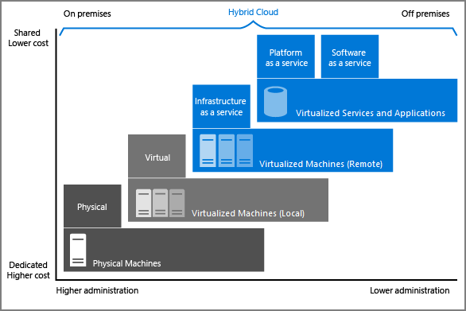
Types of clouds
Notes:
The Image illustrates several of the cloud computing concepts that are presented earlier in the session. In this example, several factors are demonstrated when you're considering where to deploy a database server in a hybrid cloud environment. As your resources move from on-premises to off-premises, your costs are reduced, and your administration requirements decrease.

Slide 30
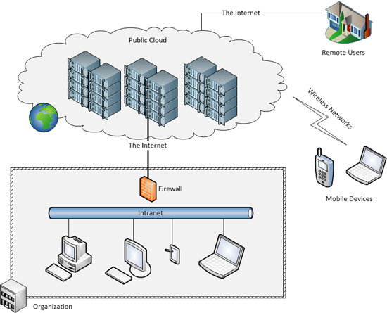
Public cloud

Slide 31
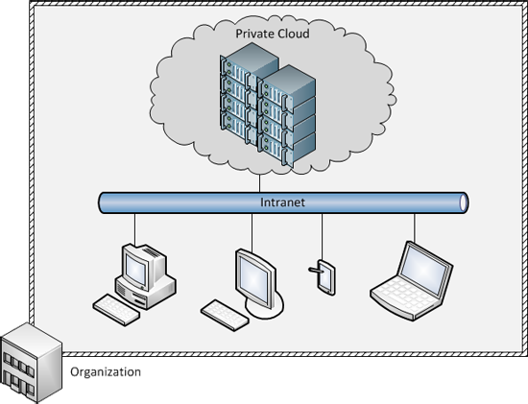
Private cloud

Slide 32
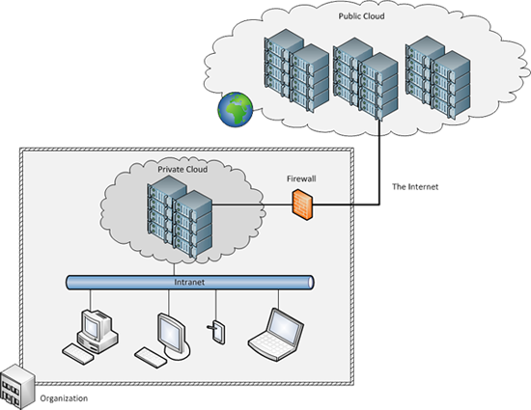
Hybrid cloud

Slide 33
Major cloud providers
1. Microsoft Azure
Compute:
Virtual Machines
Machines could run Windows or any flavors of Linux
Storage: Azure offers several storage solutions, including:
Azure Blob storage
Azure Table
Azure File Storage
Azure Cosmos DB
StorSimple

Slide 34
Major cloud providers
1. Microsoft Azure
Networking:
Azure Virtual Network
Azure ExpressRoute
Azure Traffic Manager
PaaS products: Azure offers several PaaS products:
Web Apps feature
Azure Functions
HDInsight
Azure Kubernetes Service and Azure Machine Learning.

Slide 35
Major cloud providers
2. OpenStack
Compute:
Similar services to public cloud counterparts.
OpenStack's compute system called Nova.
Storage:
An object storage service (called Swift) and
A block storage service (called Cinder).
Networking:
A pluggable, scalable, and API-driven system called Neutron.

Slide 36
Major cloud providers
2. OpenStack
PaaS products:
OpenStack itself does not have any PaaS services, but public cloud providers that are built on top of OpenStack have a few.
For example, Rackspace provides several platforms for website hosting and managed Hadoop clusters.

Slide 37
Cloud use cases
Web and mobile applications
SaaS based
PaaS based
IaaS based
Big data analytics
On-demand high-performance computing
Online storage and archival
Web-based object storage
Backup and recovery
Media streaming and content distribution:
Personal storage
Rapid application development and testing

Slide 38
Summary
Cloud computing is the delivery of computing as a service over a network, whereby distributed resources are provided to the end user as a utility. The idea of utility computing originated in the 1950s and 1960s, but the enabling technologies evolved decades later and have finally matured to a state in which cloud computing is a viable option for organizations to invest in.
The enabling technologies of cloud computing include:
Networks
Virtualization and resource management
Utility computing
Programming models
Parallel distributed computing
Storage technologies

Slide 39
Summary
Cloud computing consists of four building blocks:
Application software
Development platforms
Resource sharing
Infrastructure
Cloud service models exist at various levels in the building blocks:
Software as a service (SaaS) is at the application software layer. SaaS is the delivery of software over the internet (typically through a web browser).

Slide 40
Summary
Platform as a service (PaaS) is at the development platform layer and can be defined as a computing platform that allows for the creation of web applications in a simplified manner without the complexity of purchasing and maintaining any of the underlying software and infrastructure.
In the Infrastructure as a service (IaaS) model, providers rent out compute resources in the form of instances or virtual machines, which have some form of CPU, memory, disk, and network bandwidth attached to them.
There are three well-known deployment models for cloud computing: public, private, and hybrid.
Popular cloud providers include Amazon Web Services, Microsoft Azure, Google Cloud Platform, and OpenStack. Each provider typically offers a stack consisting of compute, storage, and networking services, among others.

Slide 41
Summary
Some of the most popular use cases for the cloud include:
Web and mobile applications
Big data analytics
On-demand high-performance computing
Online storage and archival
Rapid application development and testing

Slide 42
Introduction to Azure fundamentals

Slide 43
Microsoft Azure
Azure is a cloud computing platform with an ever-expanding set of services to help you build solutions to meet your business goals. Azure services range from simple web services for hosting your business presence in the cloud to running fully virtualized computers for you to run your custom software solutions.
Azure provides a wealth of cloud-based services like
remote storage
database hosting
centralized account management
AI and Internet of Things (IoT)

Slide 44




What does Azure offer?
Be ready for the future
Build on your terms
Operate hybrid seamlessly
Trust your cloud

Slide 45
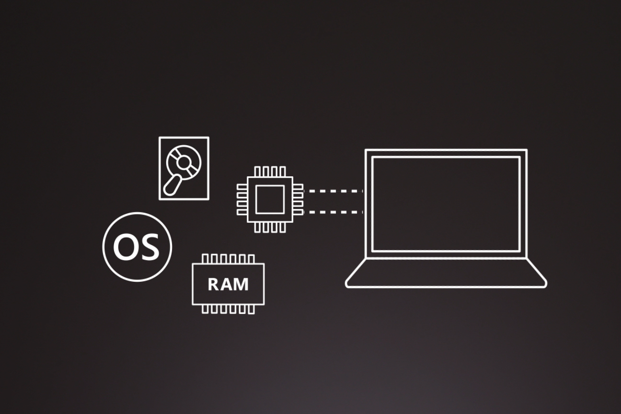
How does Azure work?

Slide 46
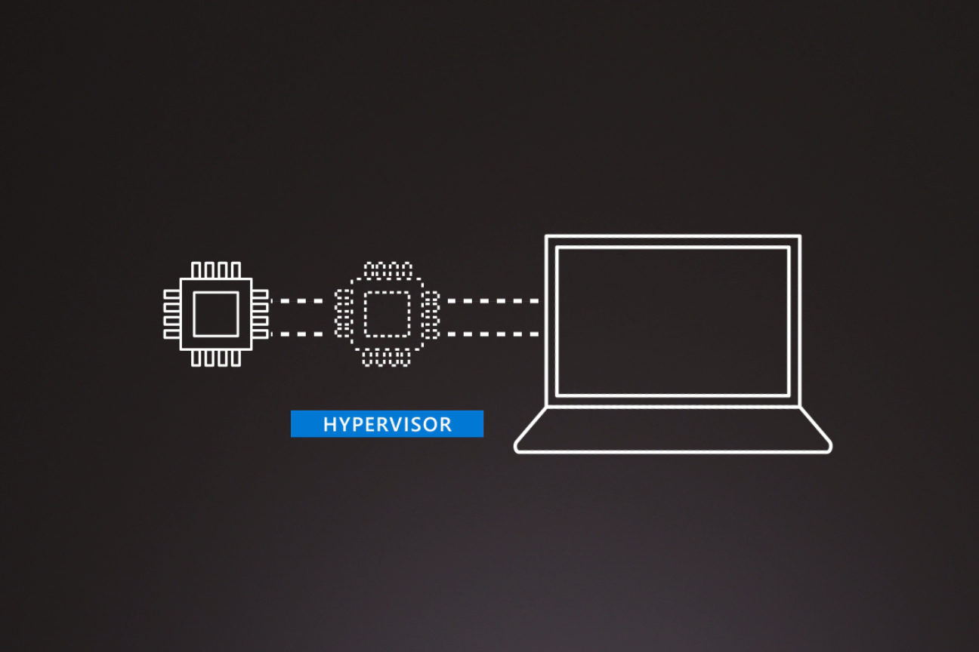
How does Azure work?

Slide 47
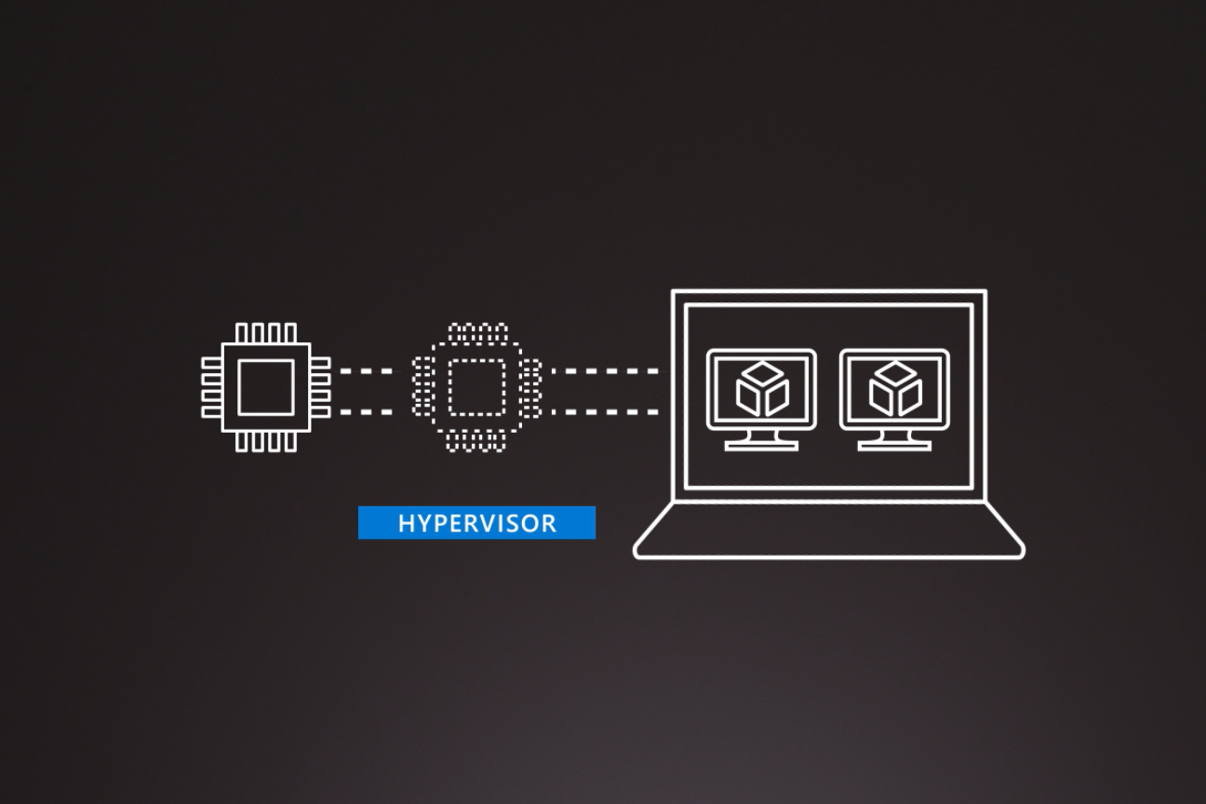
How does Azure work?

Slide 48
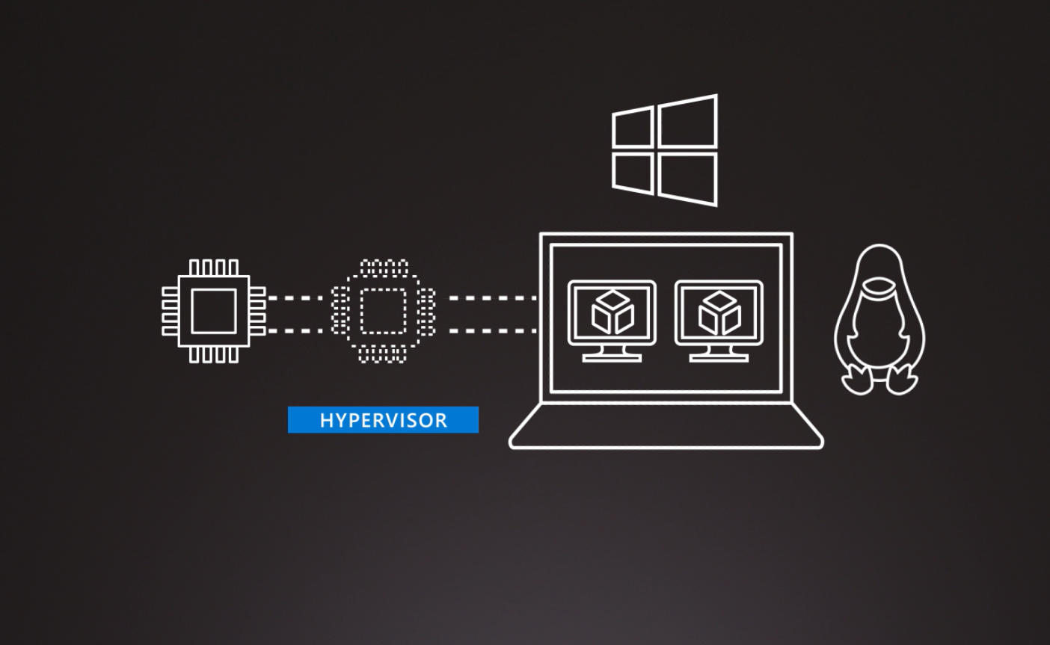
How does Azure work?

Slide 49
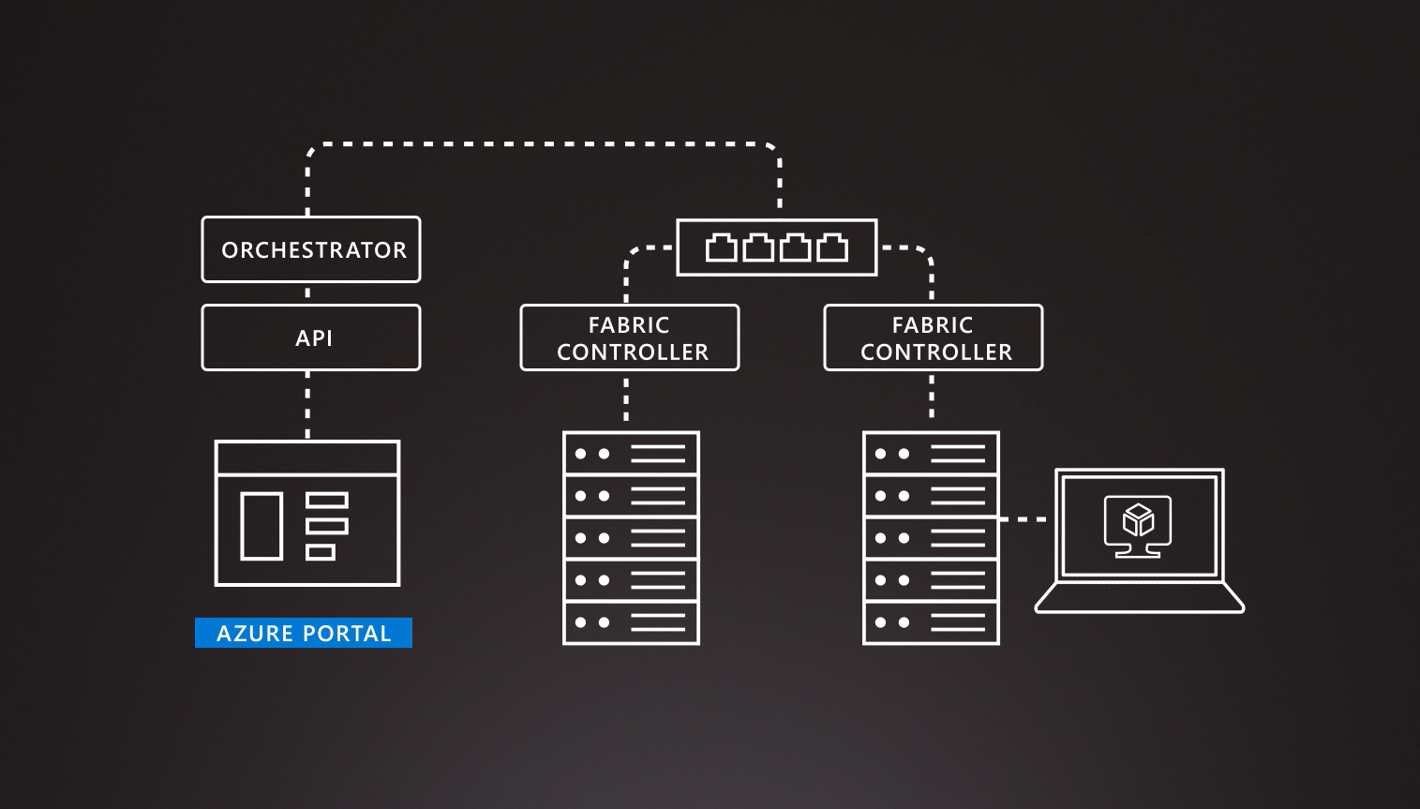
How does Azure work?

Slide 50
What can I do with Azure?
Azure provides more than 100 services like VMs and other software paradigms such as intelligent bots and mixed reality
You can use the virtual machines to run your applications.
You can also use AI and machine-learning services.
In fact a good way to start is by moving your existing applications to virtual machines that run in Azure.

Slide 51
What is the Azure portal
The Azure portal is a web-based, unified console that provides an alternative to command-line tools. With the Azure portal, you can manage your Azure subscription by using a graphical user interface. You can:
Build, manage, and monitor everything from simple web apps to complex cloud deployments.
Create custom dashboards for an organized view of resources.
Configure accessibility options for an optimal experience.
https://portal.azure.com

Slide 52
What is Azure Marketplace
Helps connect users with Microsoft partners, independent software vendors, and startups.
Customers can find, try, purchase, and provision applications and services from hundreds of leading service providers.
All solutions and services are certified to run on Azure.
The catalog provides many industry categories such as :
Open-source container platforms
Virtual machine images
Databases
Application build and deployment software
https://azuremarketplace.microsoft.com

Slide 53
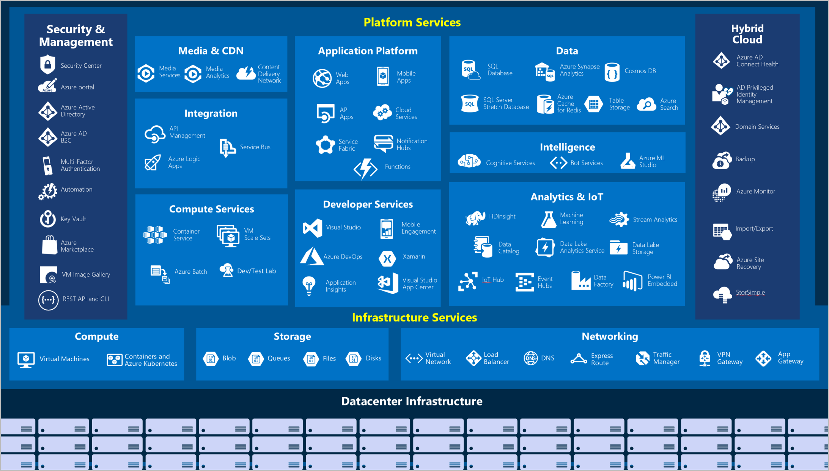
Tour of Azure services
Compute
Networking
Storage
Mobile
Databases
Web
Internet of Things (IoT)
Big data
AI
DevOps
Notes:
Azure can help you tackle tough business challenges. You bring your requirements, creativity, and favorite software development tools. Azure brings a massive global infrastructure that's always available for you to build your applications on.
Let's take a quick tour of the high-level services Azure offers.
Here's a big-picture view of the available services and features in Azure.
Compute
Compute services are often one of the primary reasons why companies move to the Azure platform. Azure provides a range of options for hosting applications and services. Here are some examples of compute services in Azure.
Azure Virtual Machines: Windows or Linux virtual machines (VMs) hosted in Azure
Azure Virtual Machine Scale Sets: Scaling for Windows or Linux VMs hosted in Azure
Azure Kubernetes Service: Cluster management for VMs that run containerized services
Azure Service Fabric: Distributed systems platform that runs in Azure or on-premises
Azure Batch: Managed service for parallel and high-performance computing applications
Azure Container Instances: Containerized apps run on Azure without provisioning servers or VMs
Azure Functions: An event-driven, serverless compute service
Networking
Linking compute resources and providing access to applications is the key function of Azure networking. Networking functionality in Azure includes a range of options to connect the outside world to services and features in the global Azure datacenters.
Here are some examples of networking services in Azure.
Azure Virtual Network: Connects VMs to incoming virtual private network (VPN) connections
Azure Load Balancer: Balances inbound and outbound connections to applications or service endpoints
Azure Application Gateway: Optimizes app server farm delivery while increasing application security
Azure VPN Gateway: Accesses Azure Virtual Networks through high-performance VPN gateways
Azure DNS: Provides ultra-fast DNS responses and ultra-high domain availability
Azure Content Delivery Network: Delivers high-bandwidth content to customers globally
Azure DDoS Protection: Protects Azure-hosted applications from distributed denial of service (DDOS) attacks
Azure Traffic Manager: Distributes network traffic across Azure regions worldwide
Azure ExpressRoute: Connects to Azure over high-bandwidth dedicated secure connections
Azure Network Watcher: Monitors and diagnoses network issues by using scenario-based analysis
Azure Firewall: Implements high-security, high-availability firewall with unlimited scalability
Azure Virtual WAN: Creates a unified wide area network (WAN) that connects local and remote sites
Storage
Azure provides four main types of storage services.
Blob storage: Storage service for very large objects, such as video files or bitmaps
Azure File storage: File shares that can be accessed and managed like a file server
Azure Queue storage: A data store for queuing and reliably delivering messages between applications
Azure Table storage: A NoSQL store that hosts unstructured data independent of any schema
Mobile
With Azure, developers can create mobile back-end services for iOS, Android, and Windows apps quickly and easily. Features that used to take time and increase project risks, such as adding corporate sign-in and then connecting to on-premises resources such as SAP, Oracle, SQL Server, and SharePoint, are now simple to include.
Databases
Azure provides multiple database services to store a wide variety of data types and volumes. And with global connectivity, this data is available to users instantly.
Azure Cosmos DB: Globally distributed database that supports NoSQL options
Azure SQL Database: Fully managed relational database with auto-scale, integral intelligence, and robust security
Azure Database for MySQL: Fully managed and scalable MySQL relational database with high availability and security
Azure Database for PostgreSQL: Fully managed and scalable PostgreSQL relational database with high availability and security
SQL Server on Azure Virtual Machines: Service that hosts enterprise SQL Server apps in the cloud
Azure Synapse Analytics: Fully managed data warehouse with integral security at every level of scale at no extra cost
Azure Database Migration Service: Service that migrates databases to the cloud with no application code changes
Azure Cache for Redis: Fully managed service caches frequently used and static data to reduce data and application latency
Azure Database for MariaDB: Fully managed and scalable MariaDB relational database with high availability and security
Web
Having a great web experience is critical in today's business world. Azure includes first-class support to build and host web apps and HTTP-based web services. The following Azure services are focused on web hosting.
Azure App Service: Quickly create powerful cloud web-based apps
Azure Notification Hubs: Send push notifications to any platform from any back end
Azure API Management: Publish APIs to developers, partners, and employees securely and at scale
Azure Cognitive Search: Deploy this fully managed search as a service
Web Apps feature of Azure App Service: Create and deploy mission-critical web apps at scale
Azure SignalR Service: Add real-time web functionalities easily.
IoT
People are able to access more information than ever before. Personal digital assistants led to smartphones, and now there are smart watches, smart thermostats, and even smart refrigerators. Personal computers used to be the norm. Now the internet allows any item that's online-capable to access valuable information. This ability for devices to garner and then relay information for data analysis is referred to as IoT.
Big data
Data comes in all formats and sizes. When we talk about big data, we're referring to large volumes of data. Data from weather systems, communications systems, genomic research, imaging platforms, and many other scenarios generate hundreds of gigabytes of data. This amount of data makes it hard to analyze and make decisions. It's often so large that traditional forms of processing and analysis are no longer appropriate.
Open-source cluster technologies have been developed to deal with these large data sets. Azure supports a broad range of technologies and services to provide big data and analytic solutions.
AI
AI, in the context of cloud computing, is based around a broad range of services, the core of which is machine learning. Machine learning is a data science technique that allows computers to use existing data to forecast future behaviors, outcomes, and trends. Using machine learning, computers learn without being explicitly programmed.
Forecasts or predictions from machine learning can make apps and devices smarter. For example, when you shop online, machine learning helps recommend other products you might like based on what you've purchased. Or when your credit card is swiped, machine learning compares the transaction to a database of transactions and helps detect fraud. And when your robot vacuum cleaner vacuums a room, machine learning helps it decide whether the job is done.

Slide 54
Get started with Azure accounts
The Azure free account is an excellent way for new users to get started. Your Free Account includes:
Free access to popular Azure products for 12 months.
A credit to spend for the first 30 days.
Access to more than 25 products that are always free.
To sign up, you need:
a phone number.
a credit card (Just for verification, you won’t be charged for the first 12 months)
a Microsoft or GitHub account.

Slide 55
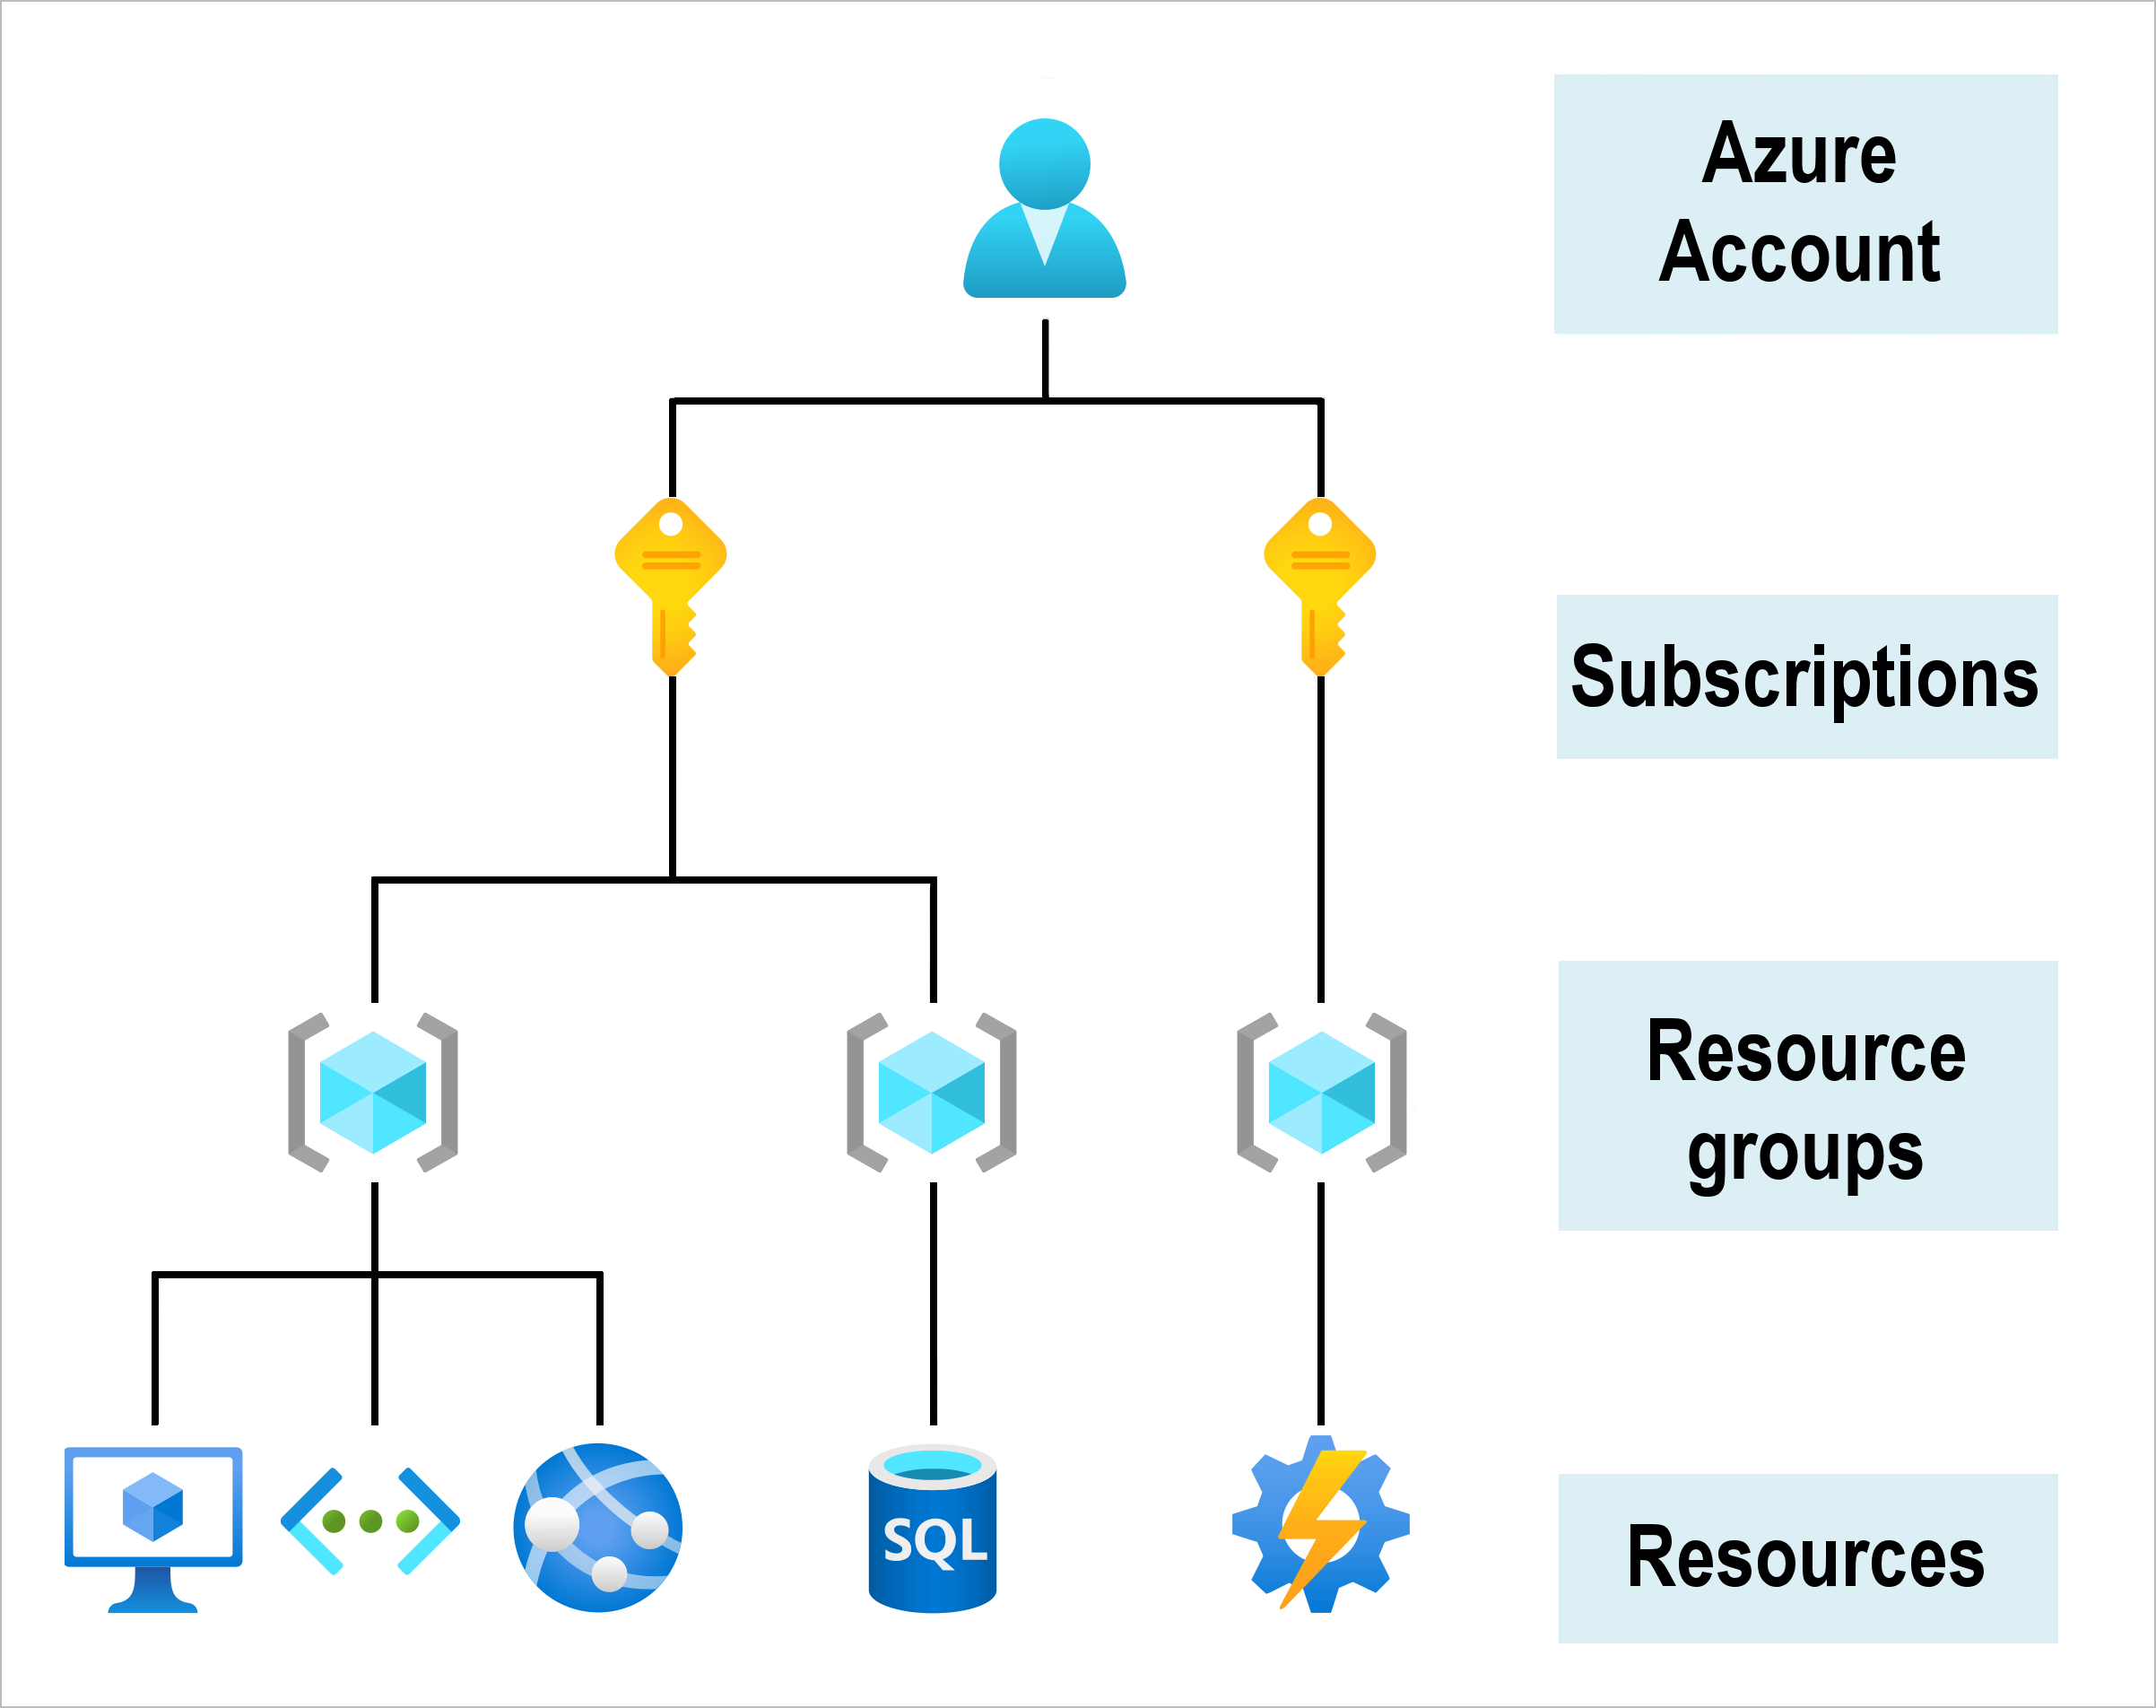
Get started with Azure accounts

Slide 56

Check your Knowledge
This Quiz consists of 18 graded questions (5 points for each question)
Time limit: 15 minutes
Source of Questions – Microsoft Learn & LinkedIn Learning
https://bit.ly/2LpJbjn Or

Slide 57

Contact Us

Slide 58
Thank you

